Slide 1
Modeling the risk of treatment discontinuation in MOUD - Subgroup analysis of disparities using Causal Machine Learning
Wanru Guo¹, Paula Jaimes Buitron², Yanmin Gong³, Yuanxiong Guo⁴, Carolina Vivas Valencia², Cici Bauer¹
¹Department of Biostatistics and Data Science, School of Public Health, UTHealth
²Department of Biomedical Engineering, University of Texas at San Antonio
³Department of Electrical and Computer Engineering, University of Texas at San Antonio
⁴Department of Department of Information Systems and Cyber Security, University of Texas at San Antonio

Slide 2
Background
Opioid use disorder (OUD) poses significant social and economic burdens in the US. Buprenorphine, an FDA-approved medication, effectively reduces opioid cravings, overdose risk, and mortality.
Despite this, treatment retention rates are low, with many patients discontinuing within six months, increasing relapse, hospitalization, and mortality risks.
Identifying factors influencing treatment discontinuation as is essential for optimizing resources and improving outcomes.

Slide 3
Current Challenges
Current studies for discontinuation risk have limited demographic (only studies Medicaid) or geographic region (specific state/ city), limiting generalizability.
Current prediction models fail to capture community-level socioeconomical factors or factors related to buprenorphine health services (mental health, counseling, psychotherapy, medication management)
Current ML and statistical methods for studying disparities in MOUD (Tx discontinuation) fail to capture their heterogenous effects across diverse populations, leading to biased findings and ineffective interventions.
Notes:
3^{rd bullet point} e.g (Gender effect on retention depends on region)

Slide 4
Motivation of study
Our study is the first to -
Leverage a Nationwide, Longitudinal buprenorphine MOUD cohort (> 100,000 patients)
Incorporate not only demographics and diagnostic variables seen in literature, but also novel community-level and health services predictors in modeling discontinuation risk
Implement a two-stage virtual twins model that prioritizes the identification of subgroups particularly vulnerable to disparities in discontinuation, enabling tailored interventions to improve treatment retention.

Slide 5
Objectives
1.Investigate the Spatial and Temporal trends of buprenorphine prescriptions and treatment episodes, and connect with socioeconomical factors (SDOH) (R Shiny App)
1
2.Model the risk of MOUD treatment discontinuation using statistical and machine learning methods
2
3.Develop a two-stage Virtual Twins ML approach to identify subgroups particularly vulnerable to gender, socioeconomical, and health insurance type disparities in discontinuation
3

Slide 6
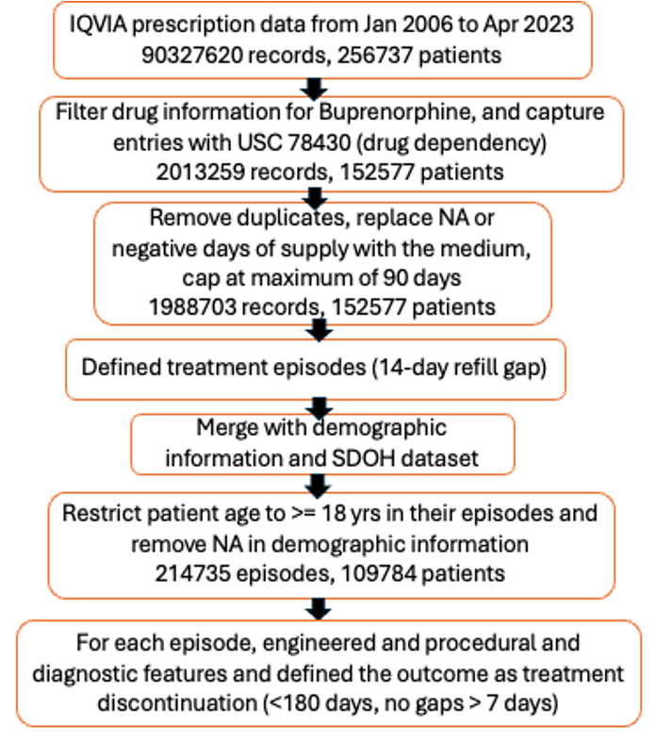
Workflow
1) episode-level data were generated from prescription information (14-day gap marks start of new episode, after sensitivity analysis)
2) discontinuation was defined as episodes lasting fewer than 180 days with no gaps exceeding 7 days)
3) Engineered Diagnostic related features (ICD9/10 codes) and Health Services features (Procedure codes/HPC) for each episode.
4) Integrated with Social Determinants of Health (SDOH) data (using 3-digit Zipcode) and (….) to engineer Socioeconomical predictors (SVI, Providers density, etc.)
Notes:
The analytical dataset is created by –
converting prescription data into buprenorphine treatment episodes data, and
2) define our outcome measure which is treatment discontinuation
3) Engineered features for each episode from demographic, procedural, and diagnostic information

Slide 7
Objectives
1.Investigate the Spatial and Temporal trends of buprenorphine treatment episodes, and connect with socioeconomical factors (SDOH) (R Shiny App)
1
2.Model the risk of MOUD treatment discontinuation using statistical and machine learning methods
2
3.Develop a two-stage Virtual Twins ML approach to identify subgroups particularly vulnerable to gender, socioeconomical, and health insurance type disparities in discontinuation
3

Slide 8
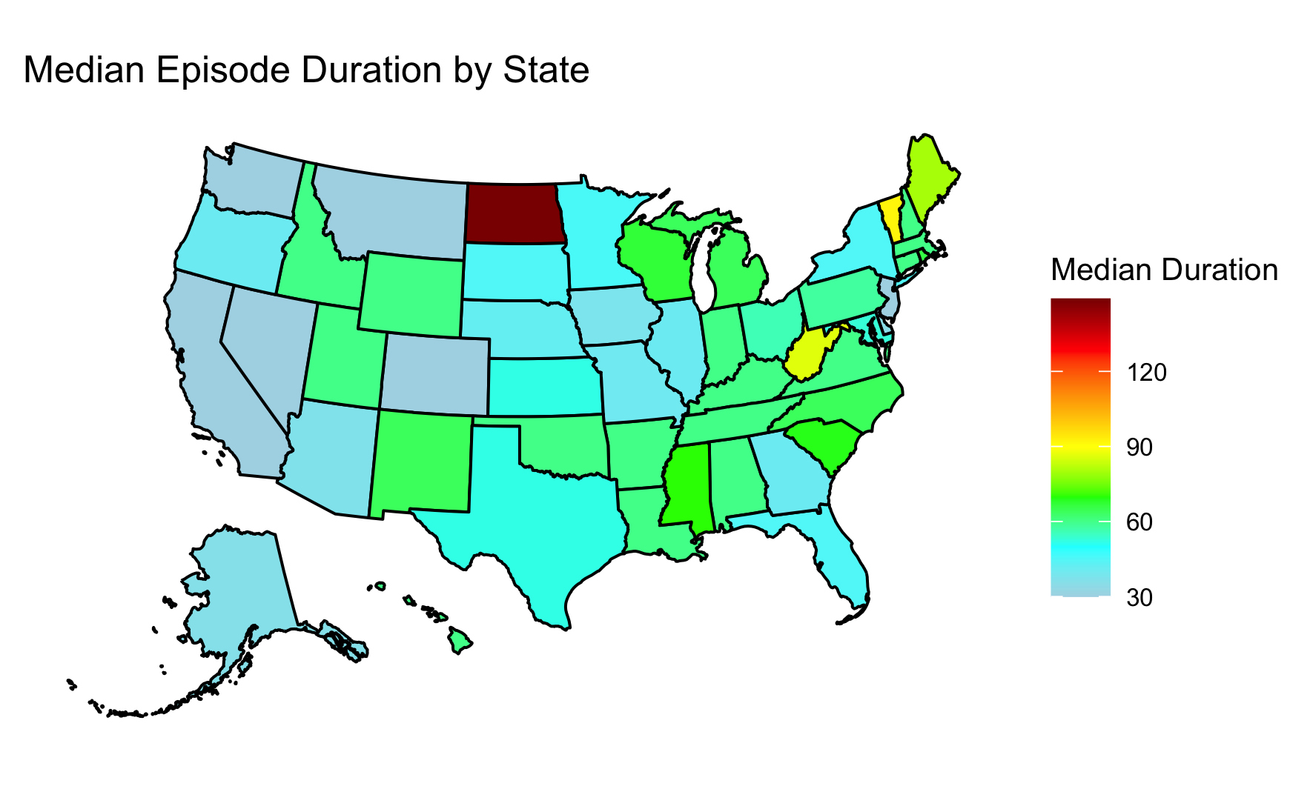
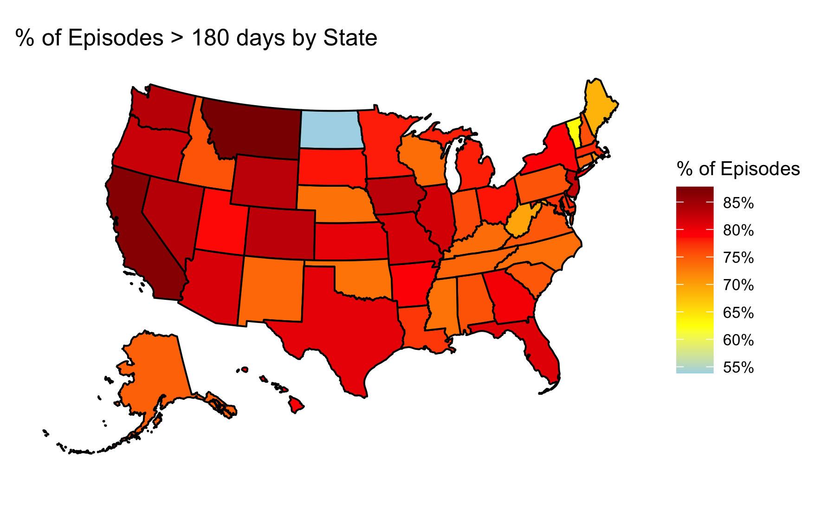
Spatial distribution of treatment episodes duration
Results
Spatial Heatmaps of episode duration
Spatial and Temporal Trends
East: Highest median durations with prolonged episodes. Midwest: Moderate durations, mostly middle range. South: Generally lower durations, some moderate values. West: Shortest durations, majority in lower range.
East: Highest percentages, many states over 80%. South: Close behind, 75–85% range. Midwest: Moderate, around 60–70%. West: Lowest, mostly below 65%, with outliers like Montana.

Slide 9
Objectives
1.Investigate the Spatial and Temporal trends of buprenorphine prescriptions and treatment episodes, and connect with socioeconomical factors (SDOH) (R Shiny App)
1
2.Model the risk of MOUD treatment discontinuation using statistical and machine learning methods
2
3.Develop a two-stage Virtual Twins ML approach to identify subgroups particularly vulnerable to gender, socioeconomical, and health insurance type disparities in discontinuation
3

Slide 10
Modelling risk of MOUD treatment Discontinuation
Engineering Features
Demographics
Comorbidities variables(Diagnosed before index date) (ICD9/10 codes)
alcohol: Alcohol use disorder nodrug: Non-opioid drug use disorder
Schizophrenia, Bipolar disorder, anxiety, Depression, PTSD, HIV, Hepatitis C
Sex, Region, age_at_first_episode_group, pay_type: Type of insurance coverage, SVI : Social vulnerability index, Computed from SDOH, Buprenorphine waivered provider density (From ….), Mental Health and Psychological Services Density (From …… )
Health Services variables (CPT/Health Procedure Codes)
Outpatient - general outpatient visits, including evaluation and management for new or established patients.
Psychiatric- These are specific to psychiatric outpatient services, including therapy sessions, consultations, and psychological testing for substance use.
Mat - additional 30min counseling provided in conjunction with medication-assisted treatment (MAT) for opioid use disorder (OUD).
Telehealth - These codes are for telehealth consultations provided by phone, allowing for remote follow-ups and counseling.
Induction -These codes cover prolonged evaluation and management services used for the induction and maintenance of buprenorphine treatment.
Bupre_tx - This code includes services provided for buprenorphine treatment during clinic visits, particularly in federally qualified health centers.
Early treatment adherence variables
pdc_90: Proportion of days covered (PDC) in the first 90 days after the index date. Adherent if ≥ 80% of days are covered, labeled adherent, otherwise non-adherent
Dayssup: Number of days initial prescription is supplied

Slide 11
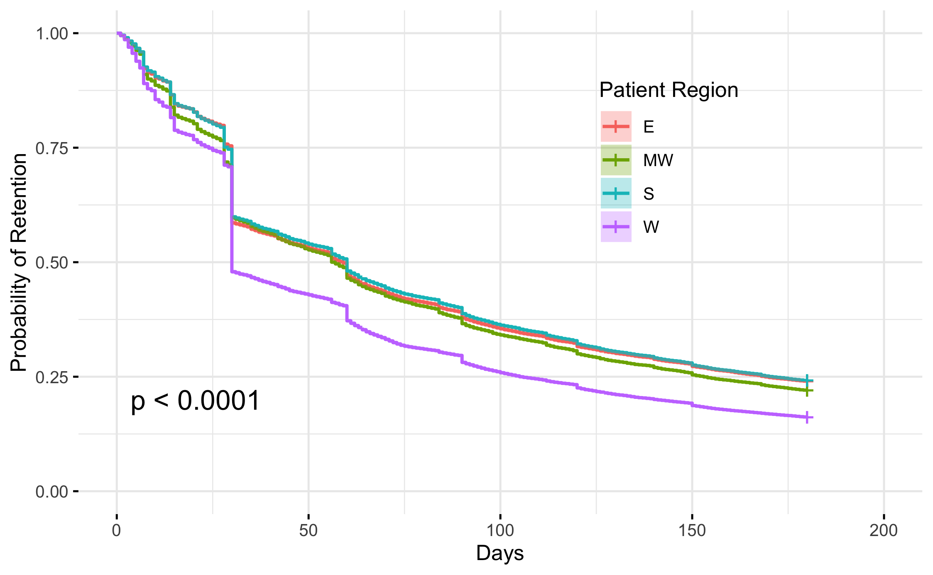
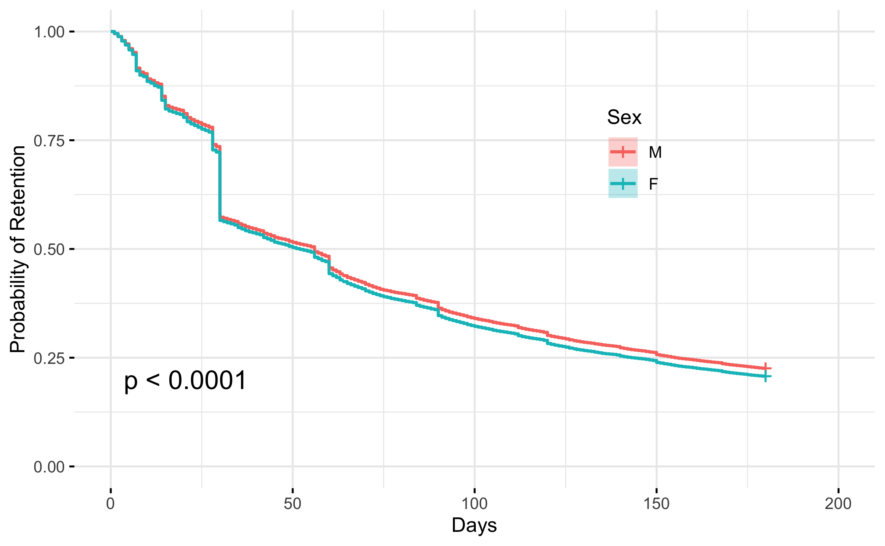
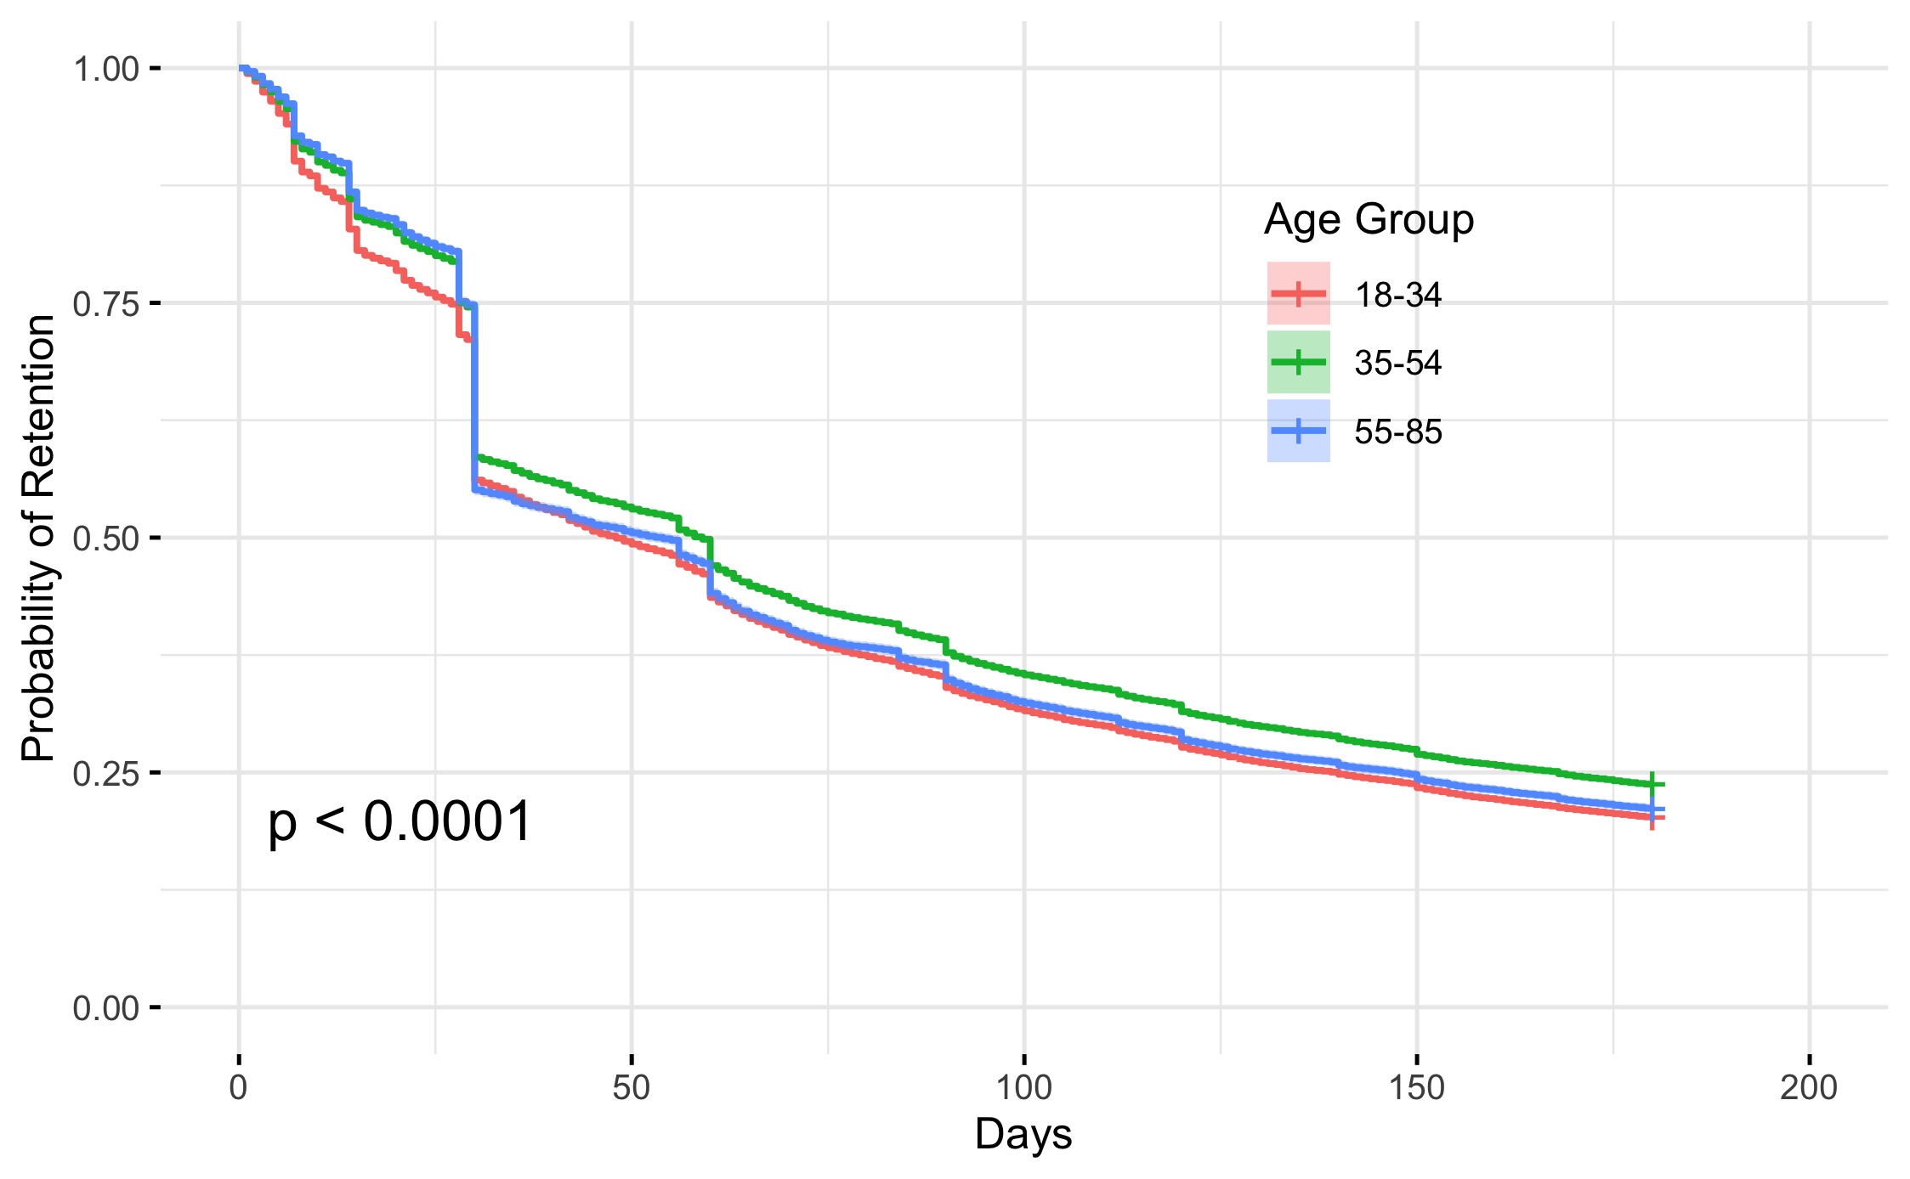
Modelling risk of MOUD treatment Discontinuation
Demographics and probability of retention
Females and patient in the West had higher hazard of discontinuation, followed by Midwest and East regions, with the South having highest treatment retention.
Middle aged groups (35-54) have higher chance of retention compared to younger (18-34) and elder groups (55-83), largely due to younger people taking more risks and elder people having more comorbidities. (discussion)

Slide 12
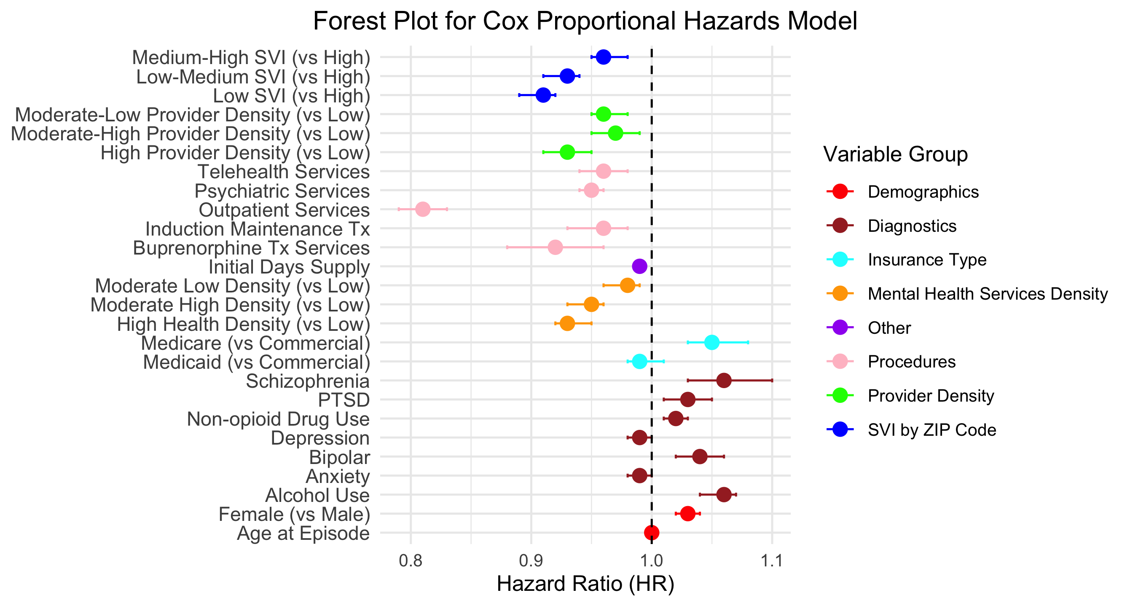
Cox PH model for time to discontinuation
Modelling risk of MOUD treatment Discontinuation
Females had higher hazard of discontinuation compared to males (HR=1.03, 95% CI: 1.02–1.04, p<.001)
Higher initial days of supply has protective effect (HR=0.99, 95% CI: 0.99–0.99, p<.001) , emphasizing importance of early treatment adherence on overall treatment retention.
Co-morbities (alcohol, non-opioid drugs, PTSD, bipolar, Schizophrenia) increase the risk of discontinuation
Health Services (Outpatient services, induction/Maintenance services, Outpatient Psychiatric services) tend to have protective effects.

Slide 13
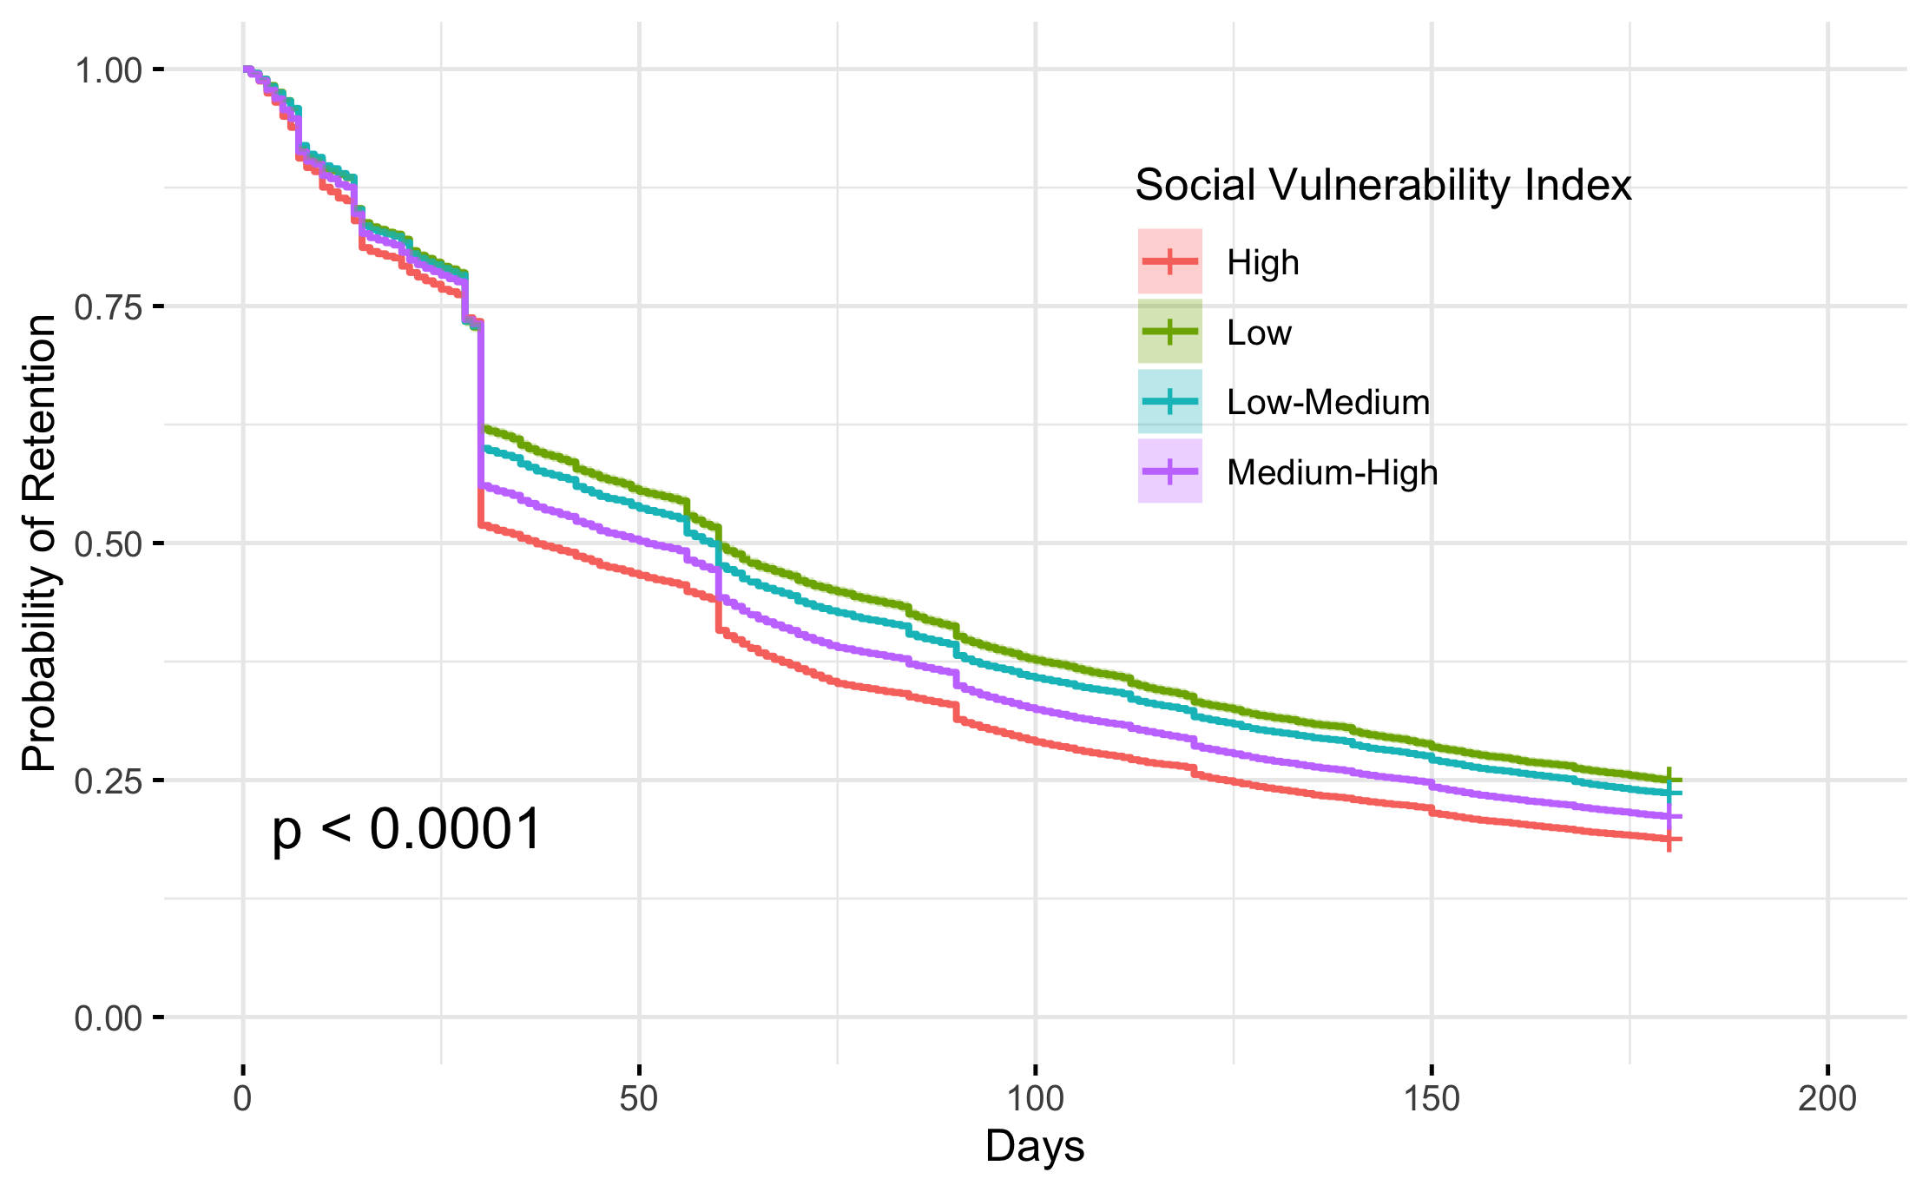
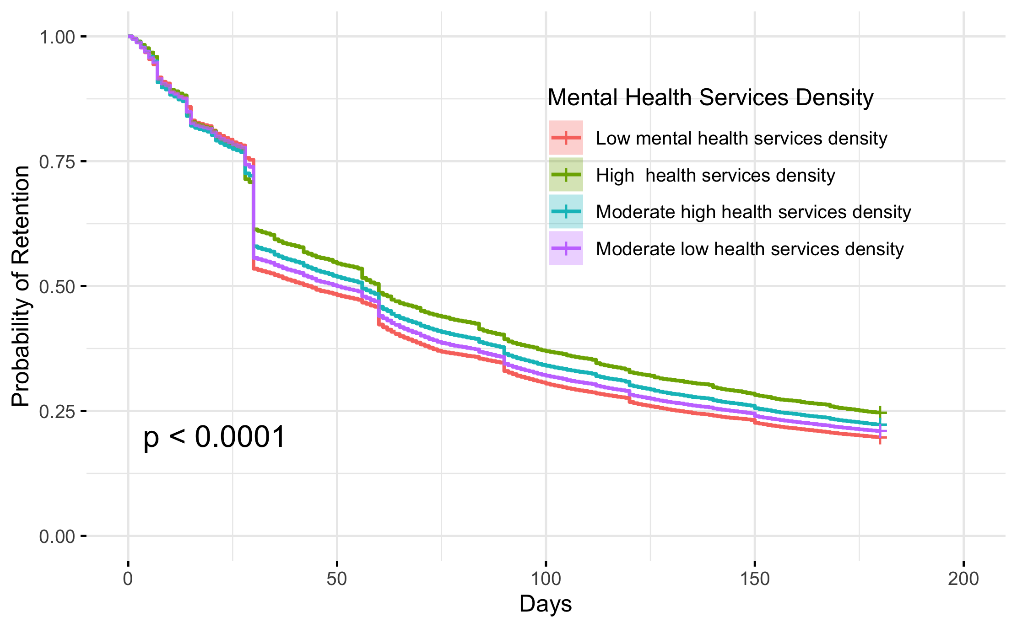
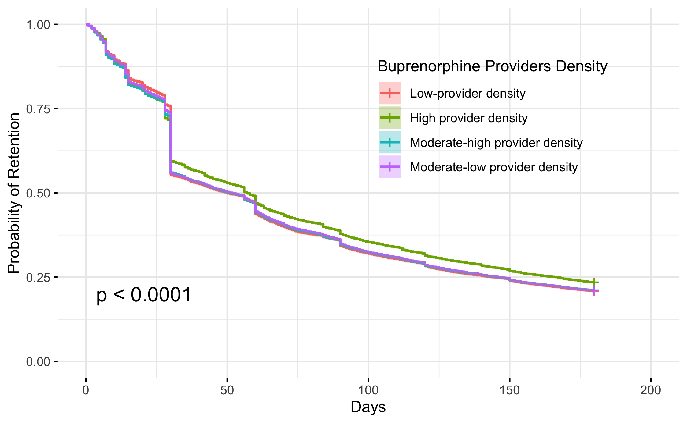
Modelling risk of MOUD treatment Discontinuation
Socioeconomic Strata and probability of retention
Strong Socioeconomical Gradient for probability of retention across all socioeconomical factors
The risk are higher with higher SVI Strata (vs Low), and lower provider and mental health services densities (vs Higher)

Slide 14
Cox PH model for time to discontinuation
Modelling risk of MOUD treatment Discontinuation
Socioeconomic Strata and probability of retention
Medium-high SVI : HR=0.96 (95% CI: 0.95–0.98, p<.001); Low-medium SVI : HR=0.93 (95% CI: 0.91–0.94, p<.001); Low SVI : HR=0.91 (95% CI: 0.89–0.92, p<.001). Vs High
Strong SVI gradient for retention probability
High provider density was associated with lower hazards (HR=0.93, 95% CI: 0.91–0.95, p<.001), while moderate-high (HR=0.97, 95% CI: 0.95–0.99, p=0.004) and moderate-low (HR=0.96, 95% CI: 0.95–0.98, p<.001) showed mixed effects.
High (HR=0.93, 95% CI: 0.92–0.95, p<.001) and moderate-high mental health service density (HR=0.95, 95% CI: 0.93–0.96, p<.001) were linked to lower hazards, while moderate-low density had a modest effect (HR=0.98, 95% CI: 0.96–0.99, p=0.007). Strong mental health services gradient for retention probability

Slide 15
Objectives
1.Investigate the Spatial and Temporal trends of buprenorphine prescriptions and treatment episodes, and connect with socioeconomical factors (SDOH) (R Shiny App)
1
2.Model the risk of MOUD treatment discontinuation using statistical and machine learning methods
2
3.Develop a two-stage Virtual Twins ML approach to identify subgroups particularly vulnerable to gender, socioeconomical, and health insurance type disparities in discontinuation
3

Slide 16
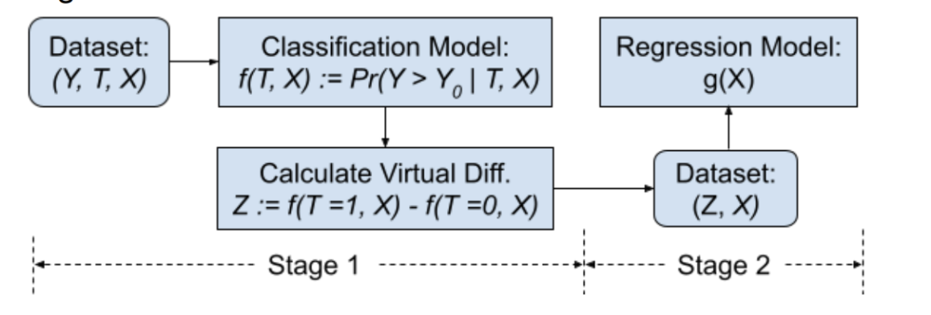
Virtual Twins Model Study Design
Y: Treatment Episode Duration (Classification: Discontinued/ Retained)
T: Disparity variable (Gender, SVI, insurance type, etc.)
X: Predictors
Train various classification models to select the one with the highest prediction accuracy.
Compute counterfactual probabilities by switching the disparity variable to its opposite value and calculate the difference (Z) for each observation.
Perform regression tree analysis using Z as the outcome and covariates (X) as predictors.
Identify subgroups particularly vulnerable to disparities.

Slide 17
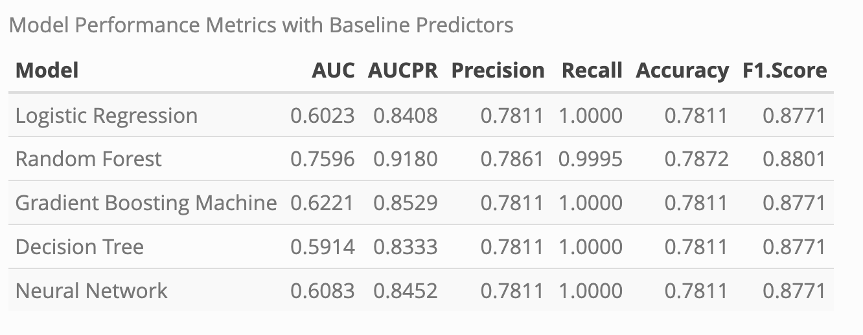
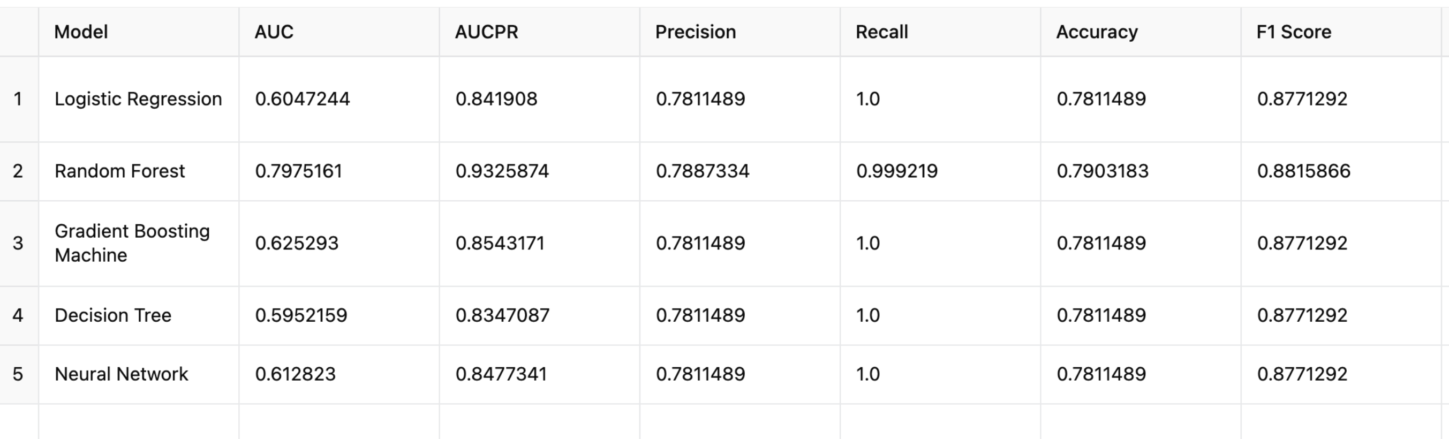
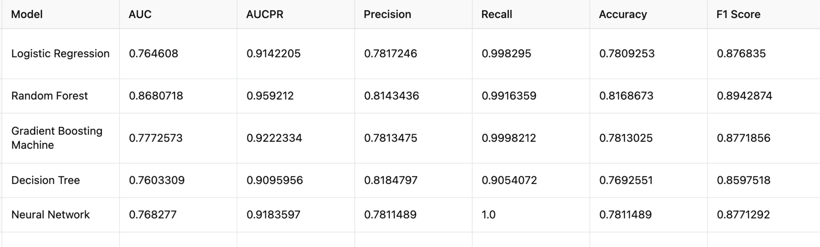
Virtual Twins Stage 1
ML models’ Prediction Performance for risk of discontinuation (Set 1)
Baseline Demographic, Diagnostic, and Health Services predictors
Baseline Predictors + Social Vulnerability Index (SVI) (Integrated using SDOH)
Baseline Predictors + SVI + PDC90 (Proportion of Days Covered by Treatment in First 90 Days From Start of the First Episode)

Slide 18
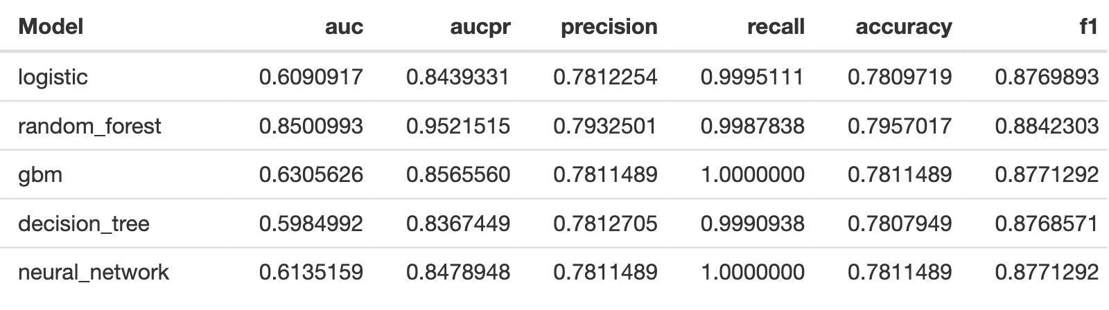
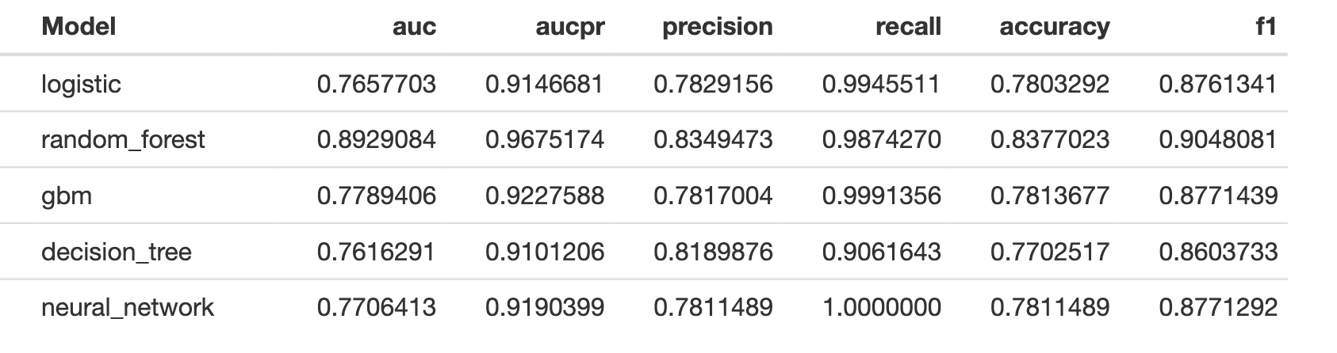
Virtual Twins Stage 1
ML models’ Prediction Performance for risk of discontinuation (Set 2)
Baseline Demographic, Diagnostic, and Health Services predictors
Baseline Predictors + Community-level Predictors (SVI + provider’s density + mental health services density
Baseline Predictors + Community-level Predictors + PDC_90

Slide 19
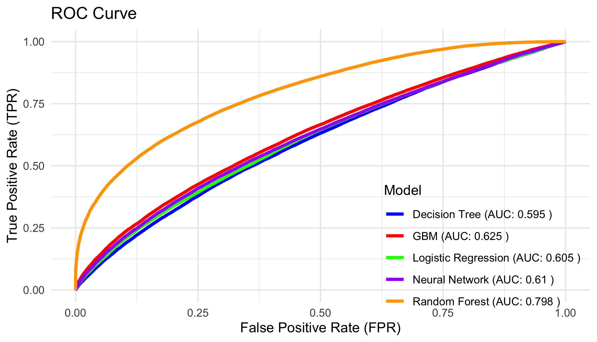
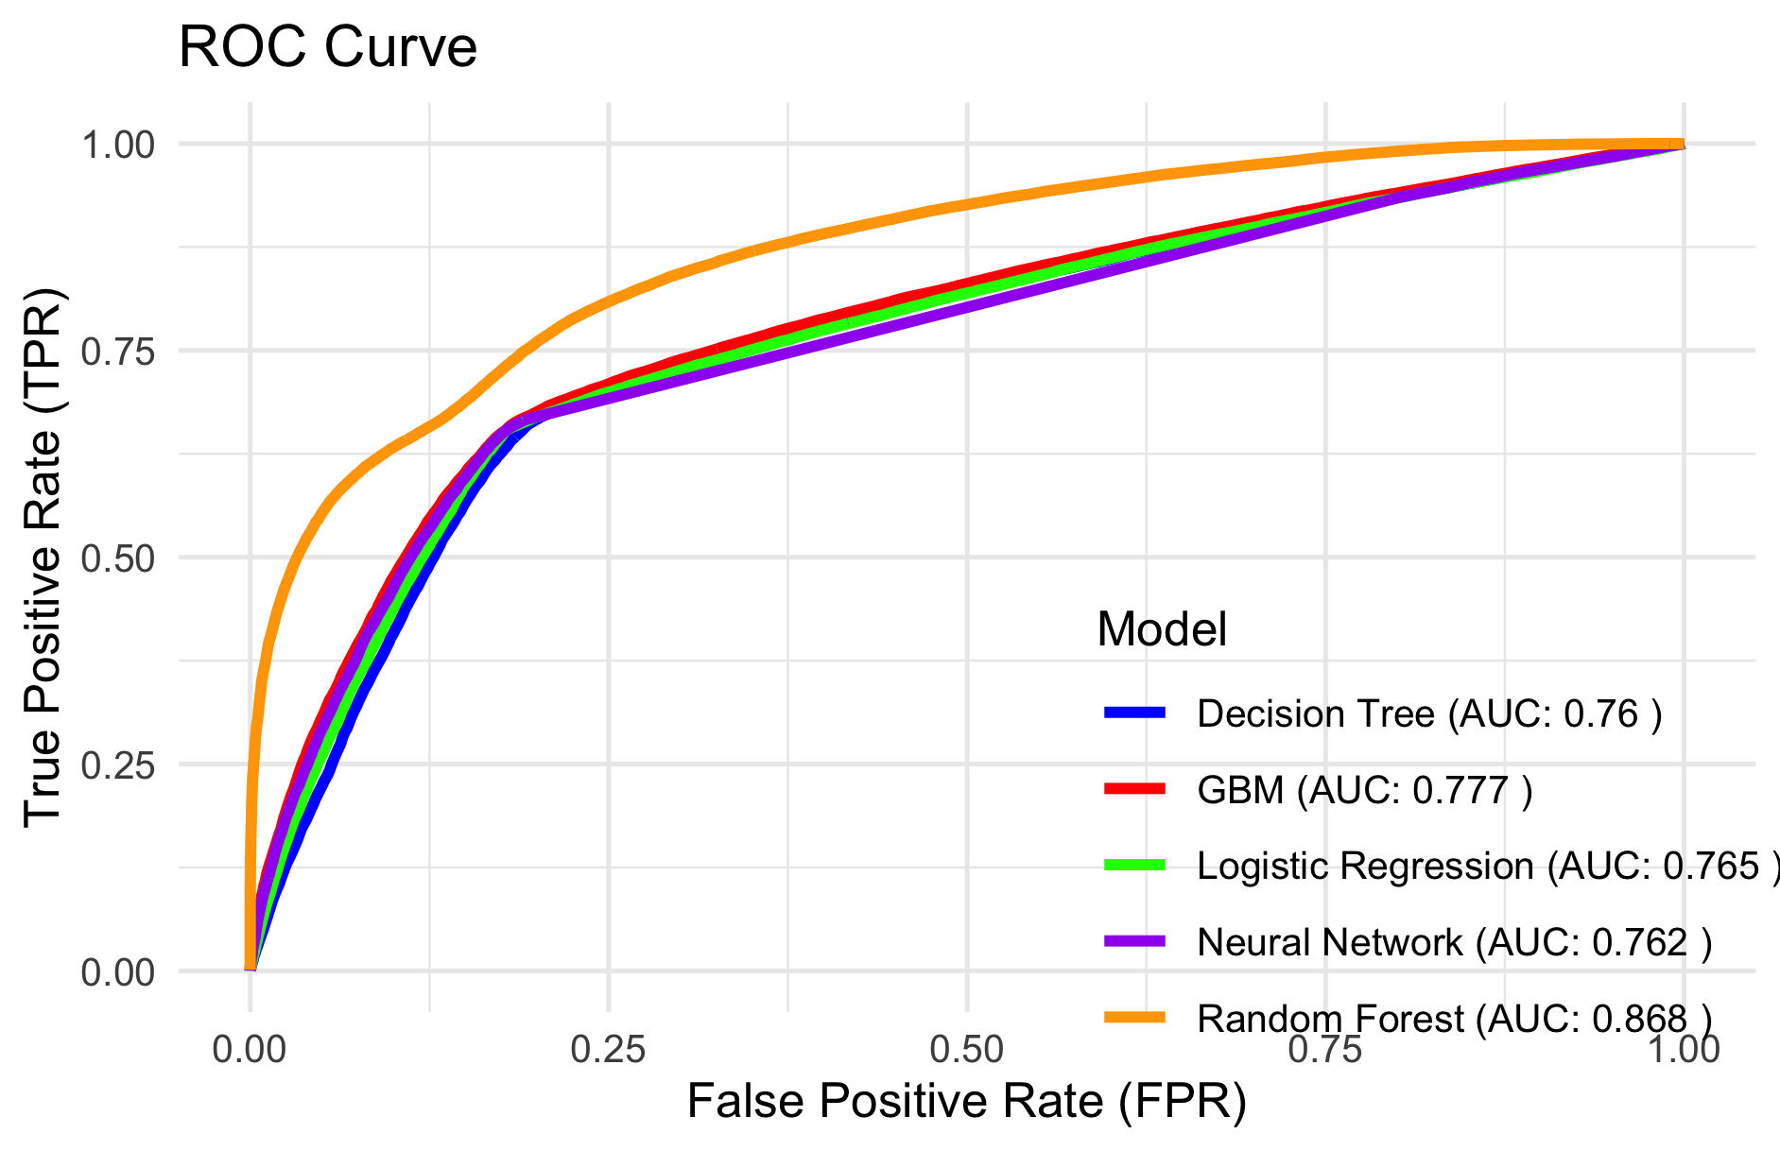
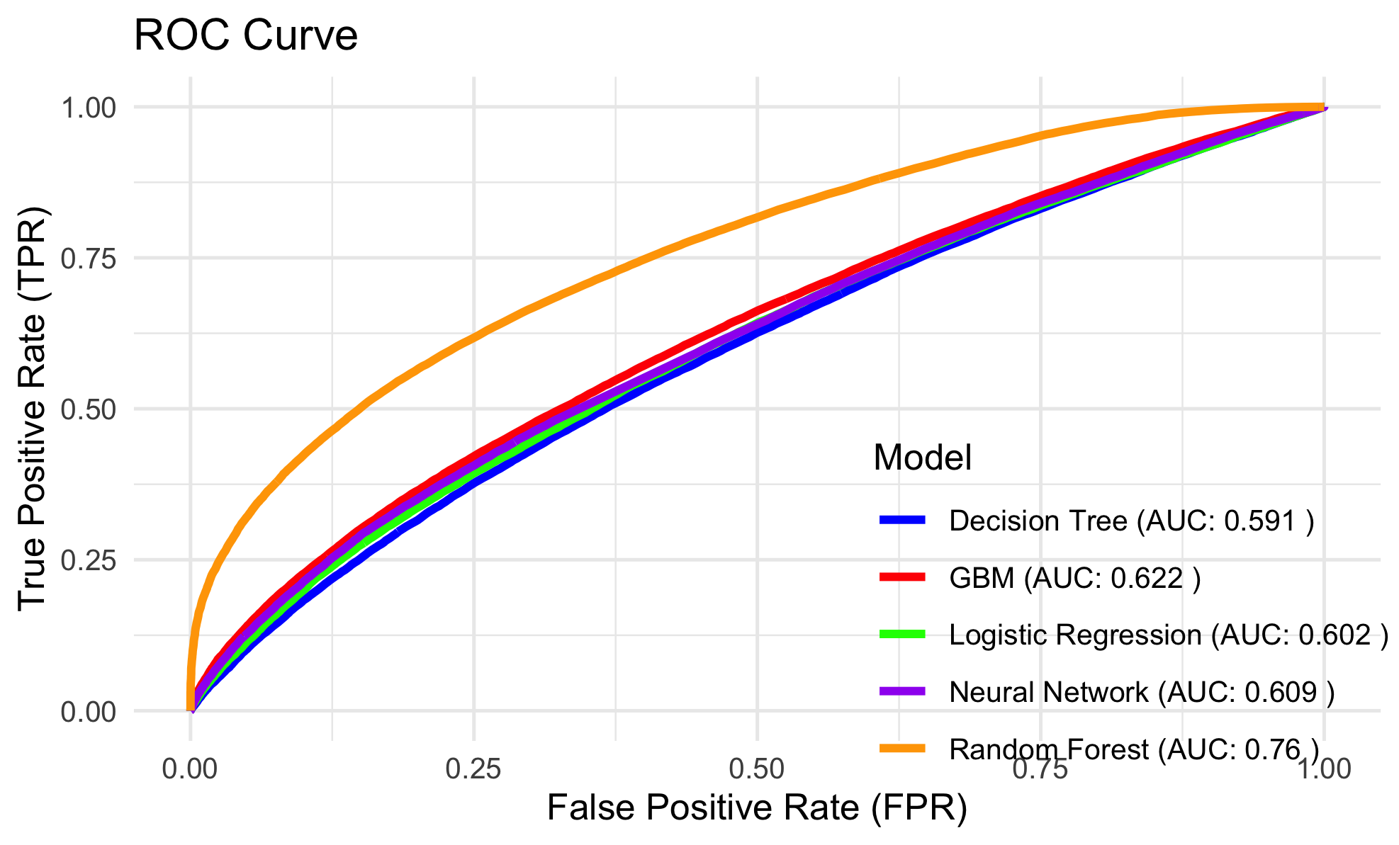
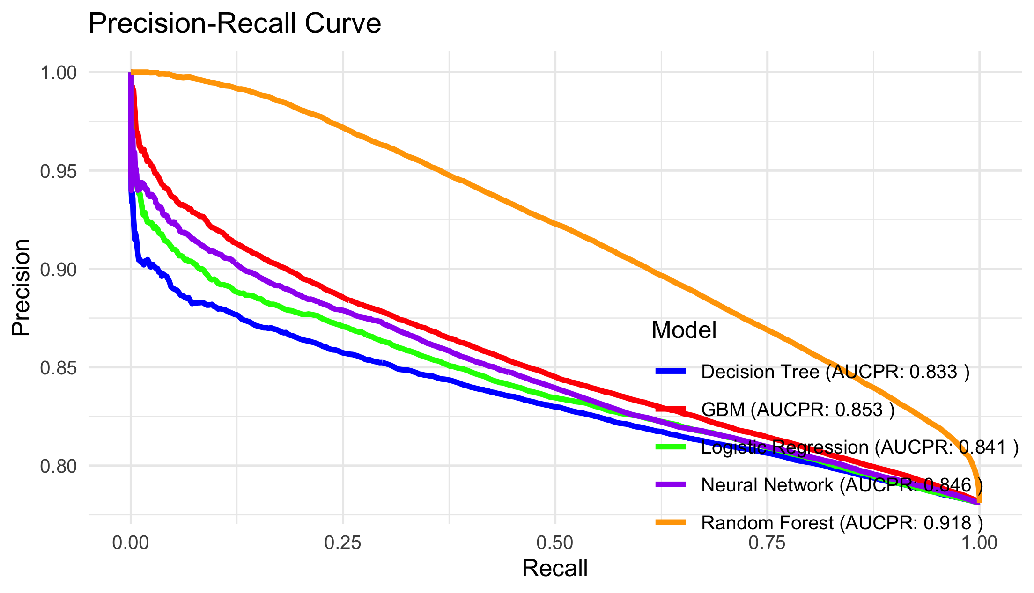
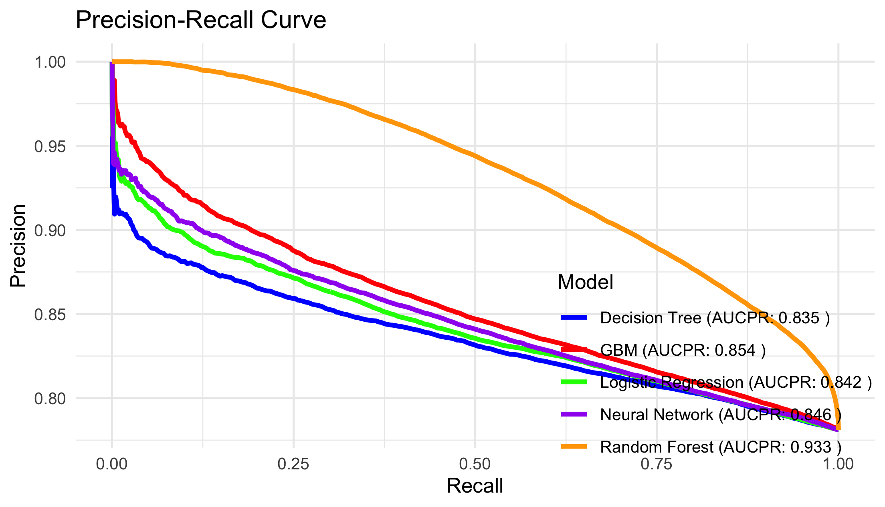
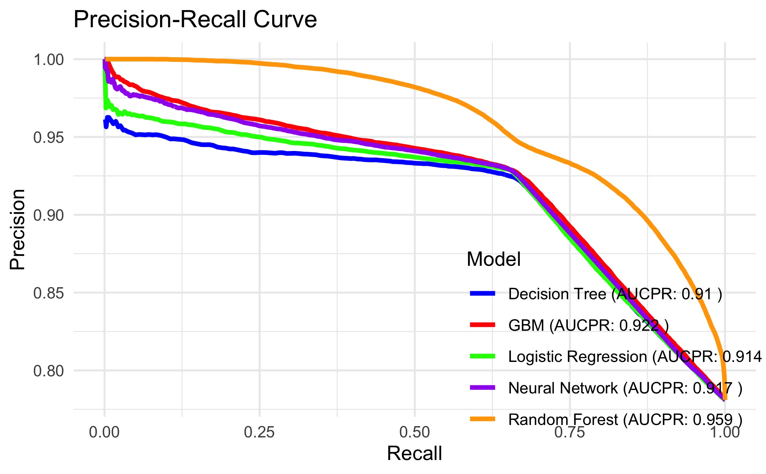
Virtual Twins Stage 1 Results
ROC and PR curves for risk of discontinuation (Set 1)
Baseline Predictors + SVI + PDC90
Baseline predictors
Baseline Predictors + Social Vulnerability Index (SVI)

Slide 20
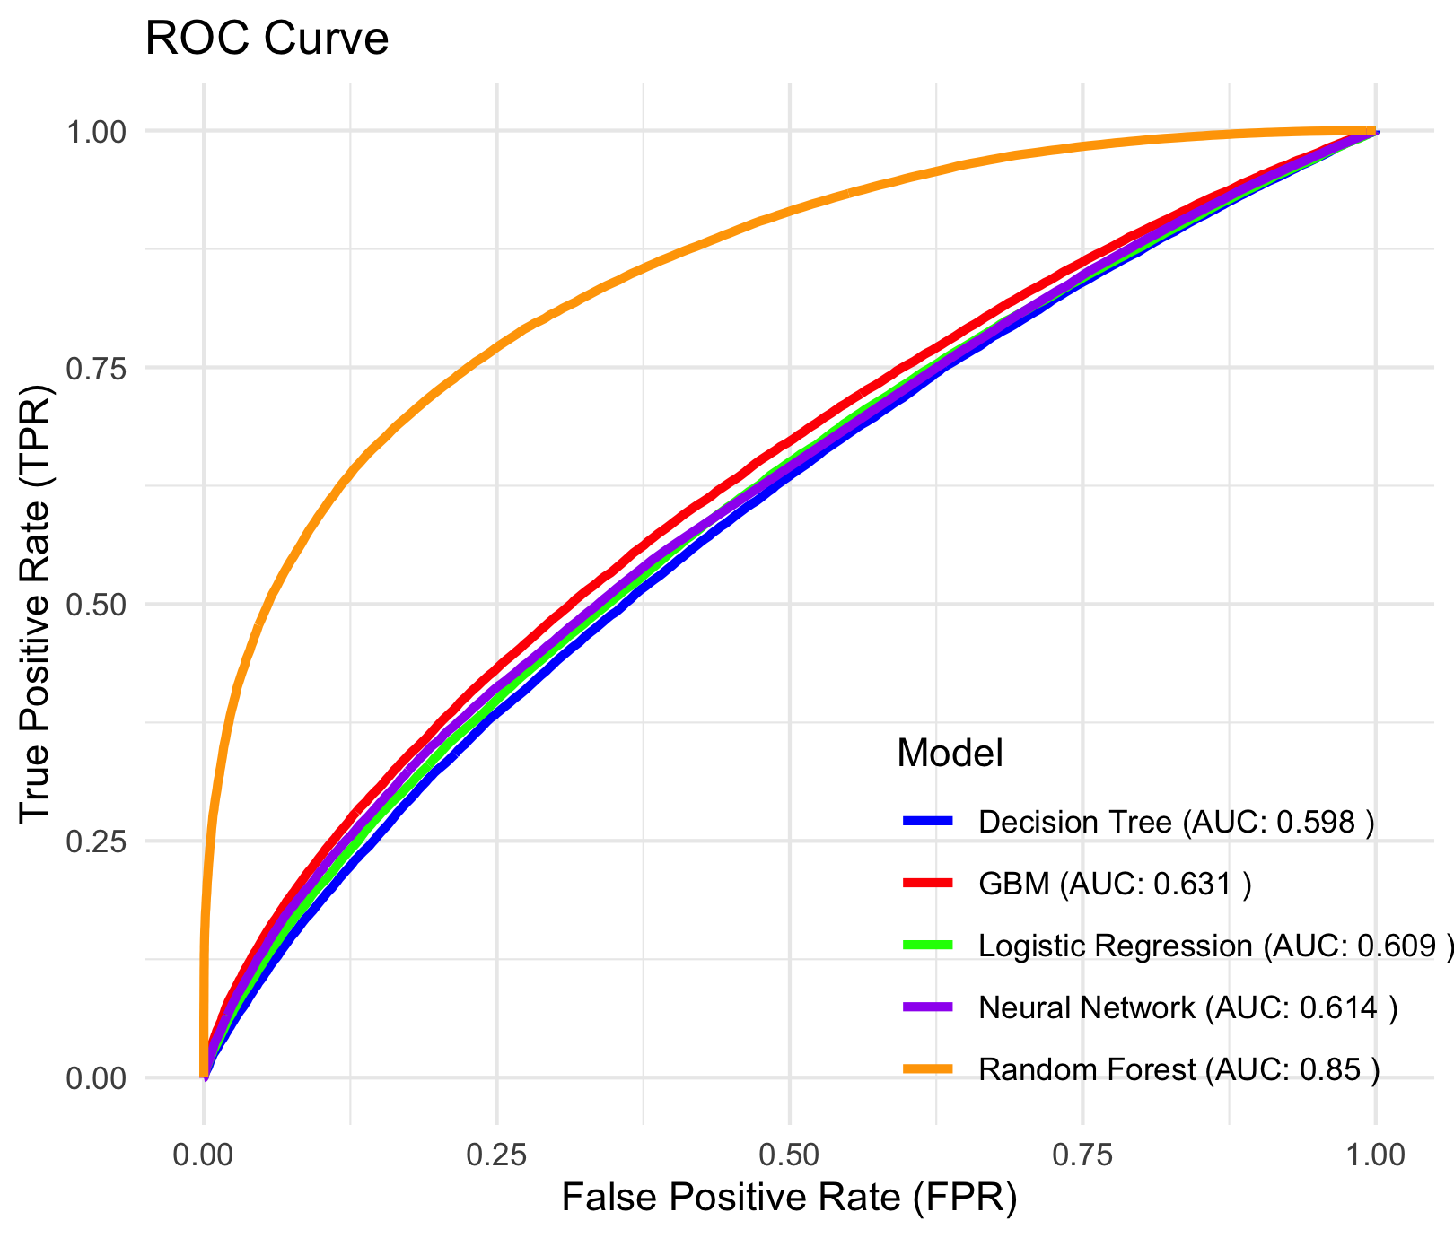
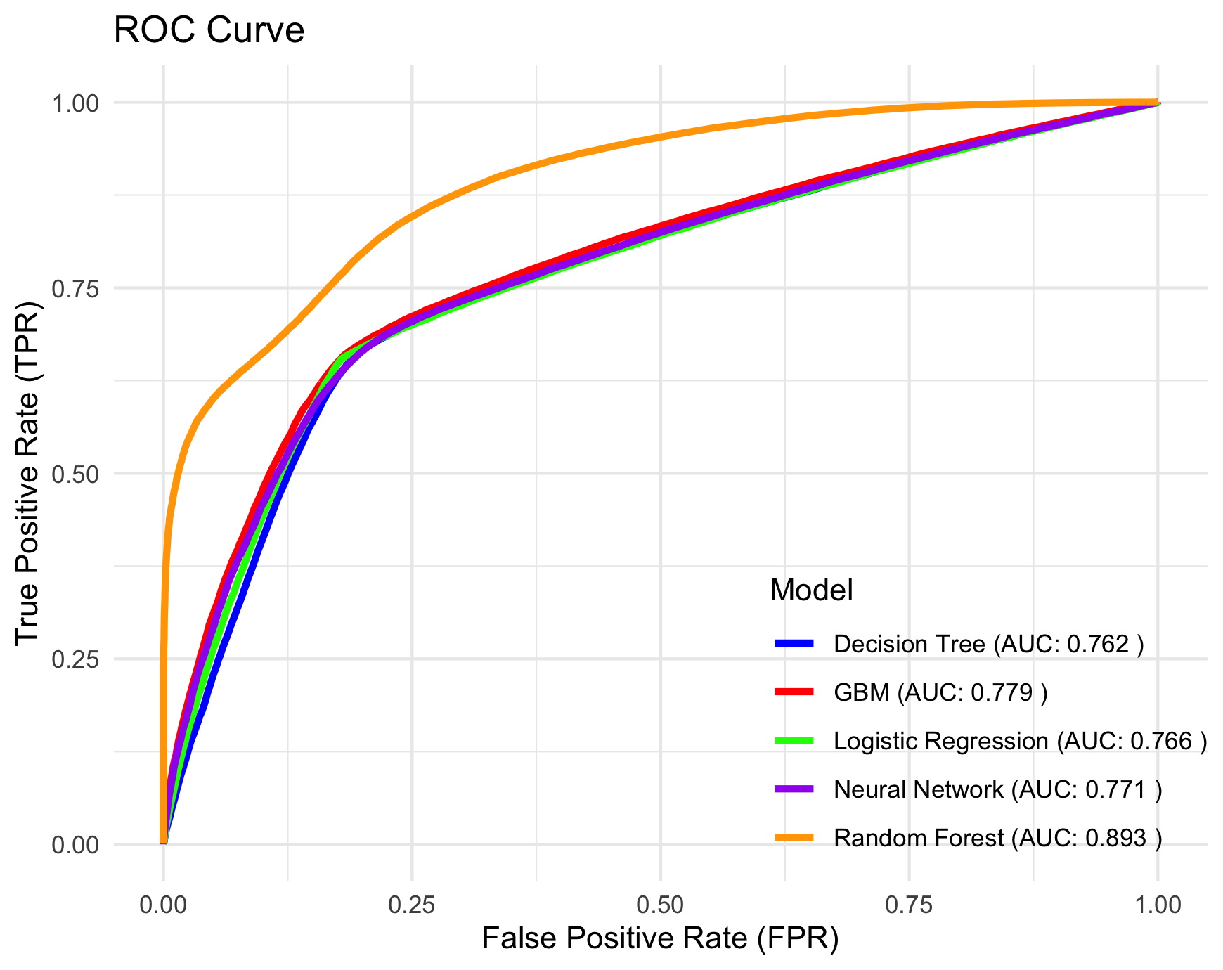
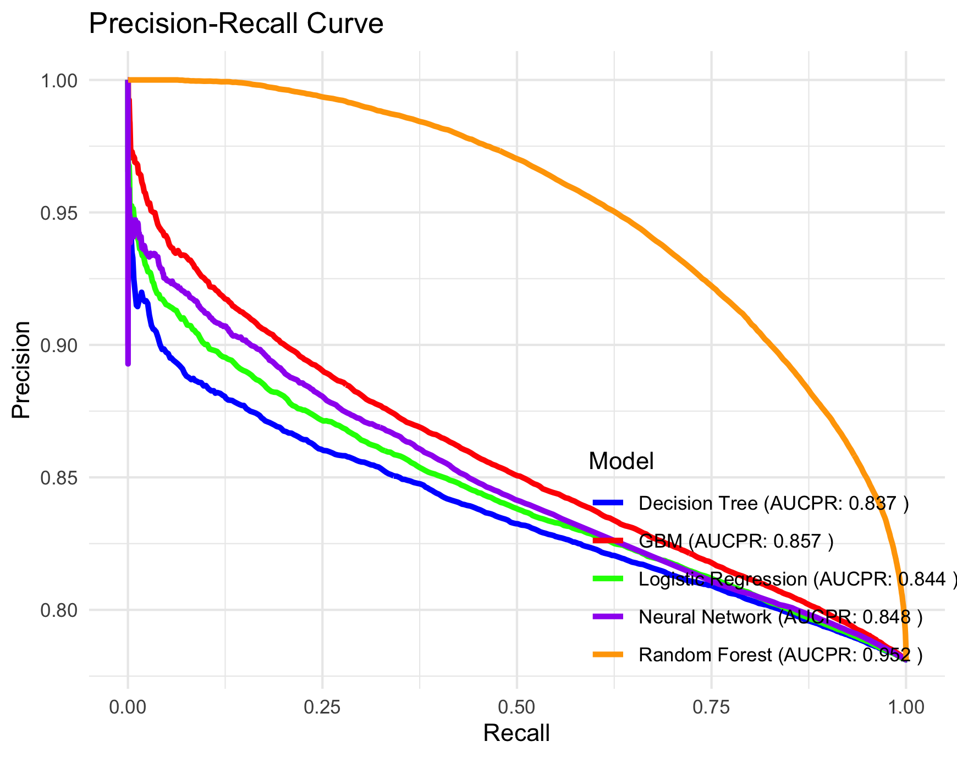
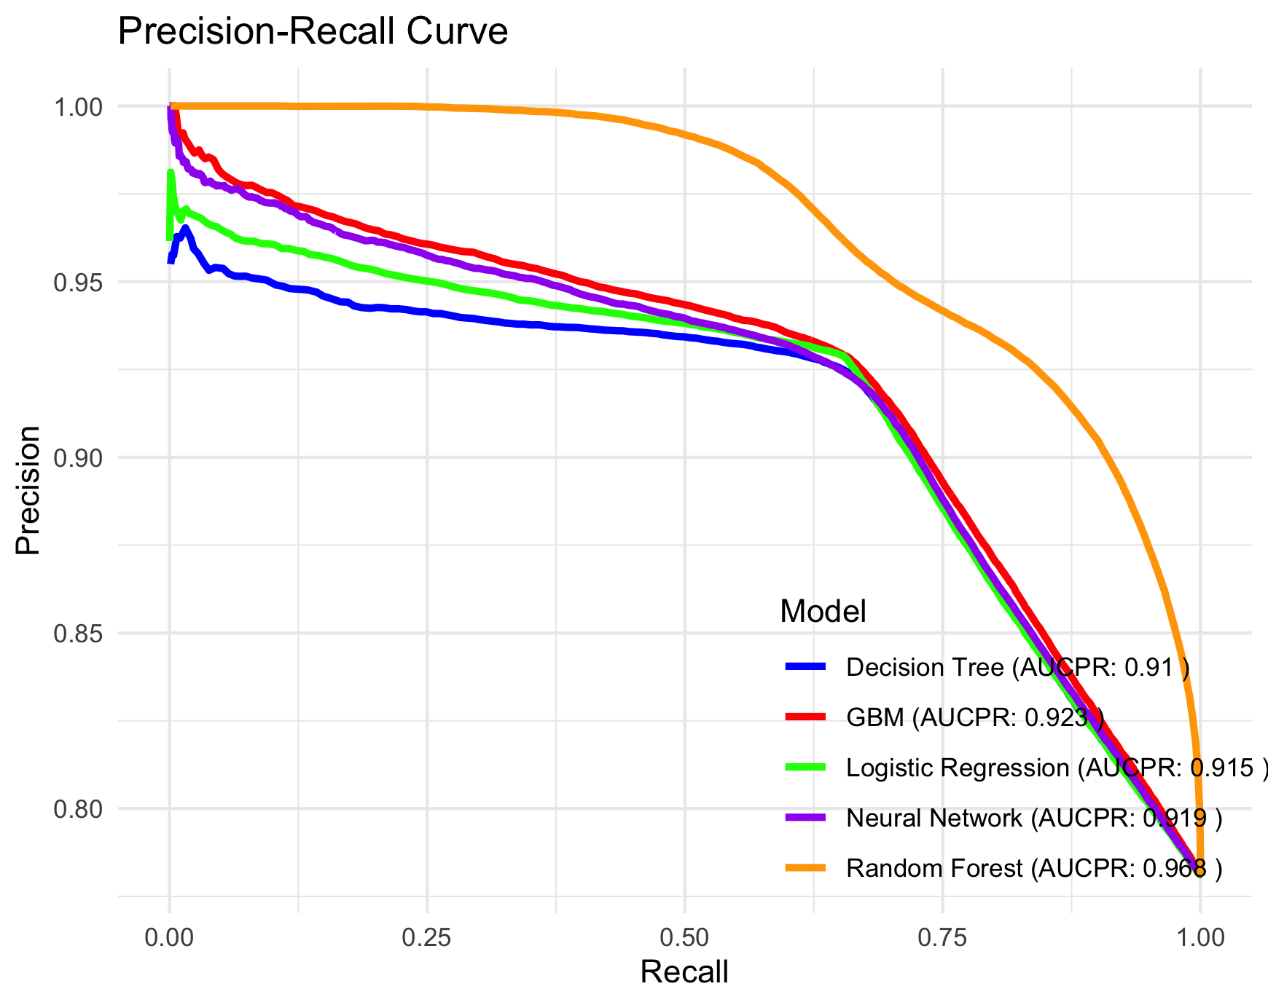
Virtual Twins Stage 1 Results
ROC and PR curves for risk of discontinuation (Set 2)
Baseline Predictors + Community-level Predictors (SVI + provider’s density + mental health services density
Baseline Predictors + Community-level Predictors + PDC_90
Baseline predictors

Slide 21
Virtual Twins Stage 1
Summary of prediction models
C-Statistic ranged 0.591 - 0.760 for models with baseline demographic, Comorbidities and Health Services predictors, AUCPR ranged between 0.833- 0.918.
Incorporating Socioeconomic predictor (SVI) improved model performance (C statistic: 0.595 to 0.798; AUCPR: 0.835 to 0.933), Highlighting their importance in risk prediction.
Interestingly, further incorporating community-level predictors (providers density, mental health services density) improved model performance (C statistic: 0.598 to 0.85; AUCPR: 0.837 to 0.952), Highlighting the indispensable role of community-level predictors
Incorporating Proportion of days covered by treatment in the first 3 months (PDC_90) further enhanced model performance (C statistic: 0.762 to 0.893; AUCPR : 0.910 to 0.968), proving the positive impact of early adherence on treatment retention.
RF was chosen for disparities analysis in stage 2 since it is the best performer.

Slide 22
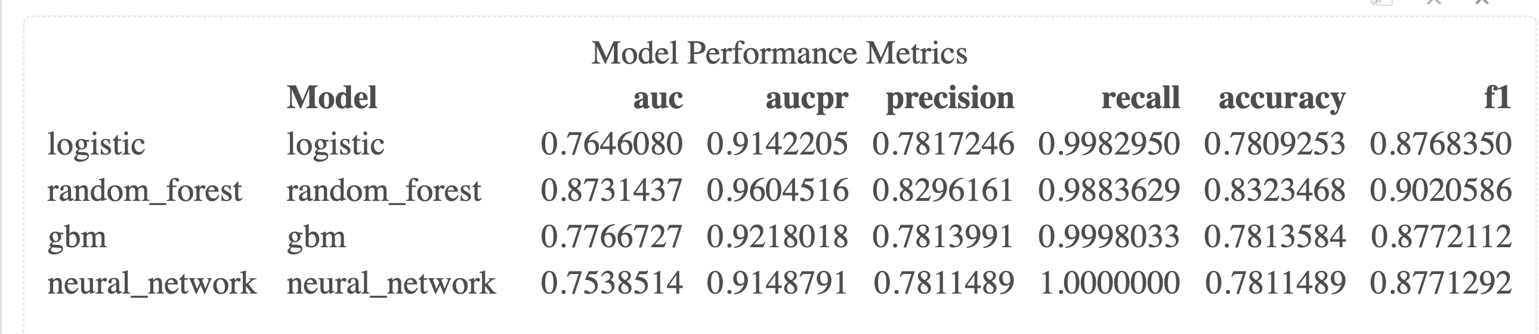
Virtual Twins Stage 1
Robustness of models to class imbalance
Prediction using Baseline predictors + SVI + PDC_90
Out-of-sample statistics using SMOTE are very similar to the statistics resulting for the analyses run using the original data.
Since both precision and recall are high and consistent with each other, we conclude that the results of the prediction models are not imbalanced in favor of only one class
Prediction using Baseline predictors + SVI + PDC_90
After SMOTE (Synthetic Minority Oversampling Technique)

Slide 23
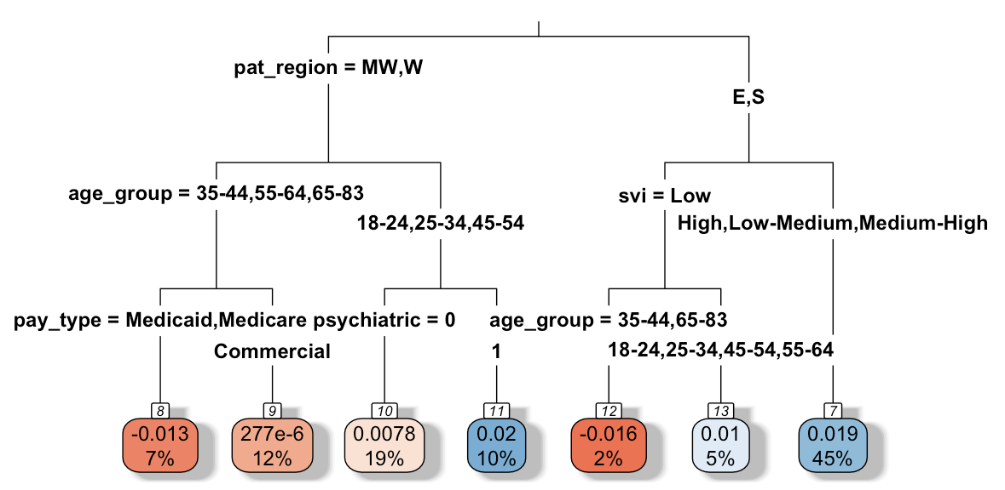
Stage 2 Results
Subgroups identified for gender, SVI, and Health Insurance Disparities
Subgroup Identification for Gender Disparities Z = Prf(Sex=F, Xi) - Prf (Sex=M, Xi)
Females are at higher risk of discontinuation particularly in the East and South regions, with higher social vulnerability, this represents as much as 45% of the cohort. In regions with lower SVI, the affect of gender on discontinuation depends on age.
In contrast, this sex disparity is mitigated for patients in the MidWest/ West regions, in the age groups 35-44 and 55+, and those with Medicare/ Medicaid insurance. For other age groups in the same region, the effect of sex on risk of discontinuation depends on whether the patient receives psychiatric services for substance use.

Slide 24
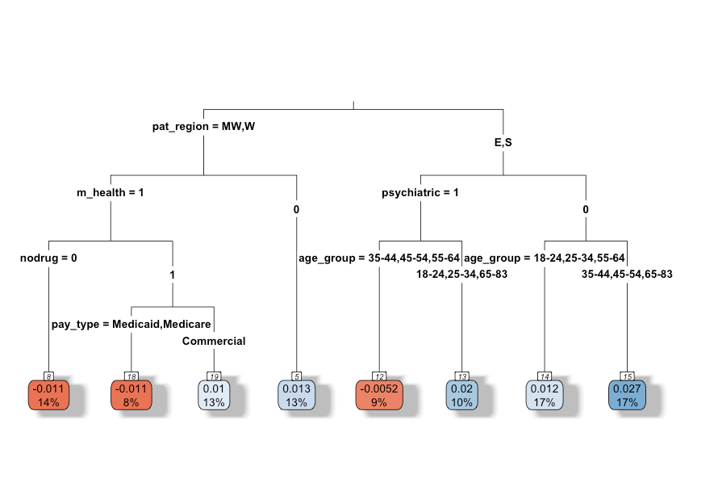
Stage 2 Results
Subgroups identified for gender, SVI, and Health Insurance Disparities
The risk of discontinuation increases with higher SVI group, and this effect is more pronounced in East and South regions, for patients who did not receive psychiatric services for substance use, and those ages 35-54 and 65+, this represents 17% of the population. It is less pronounced for patients receiving psychiatric services for substance use.
In the contrary, the disparity of SVI on risk of discontinuation is negated for patients residing in West/Midwest regions, with a mental health diagnosis, and either not using non-opioid drugs or using non-opioid drugs and have Medicare. For patients without a mental health condition diagnosis, increase in SVI still increases the risk of discontinuation.
Subgroup Identification for SVI Disparities Z = Prf(SVI=High, Xi) - Prf (SVI-Low, Xi)

Slide 25
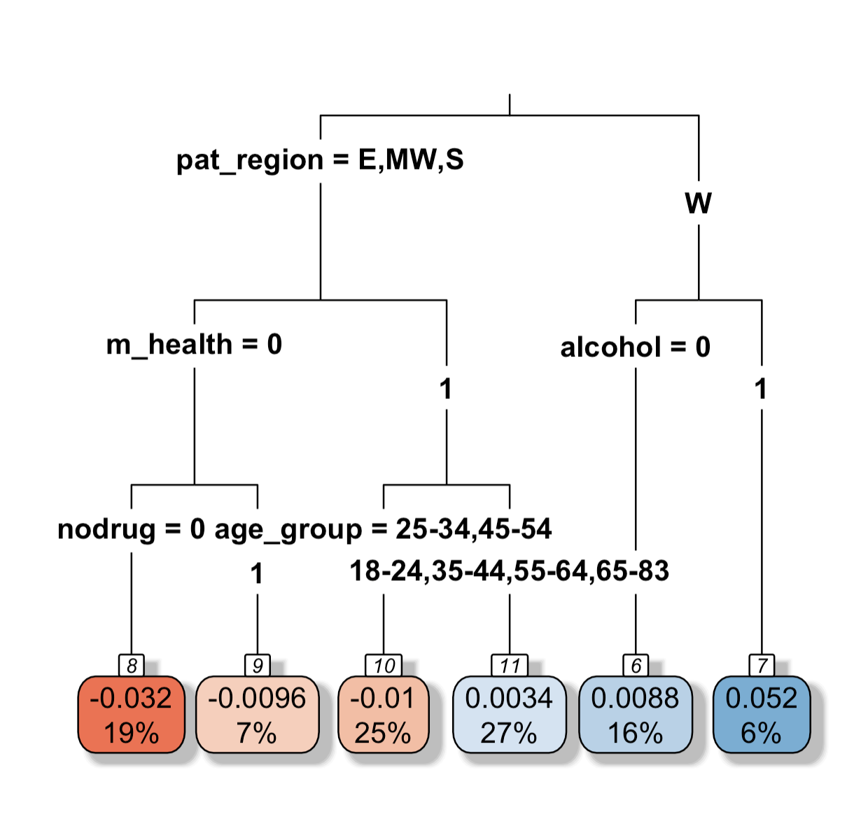
Stage 2 Results
Subgroups identified for gender, SVI, and Health Insurance Disparities
Subgroup Identification for Insurance Disparities Z = Prf(paytype=Private*, Xi) - Prf (paytype=Public*, Xi)
Commercially insured and self-insured patients are at higher risk of discontinuation of OUD treatment especially in the West region and more pronounced when they drink alcohol, likely due to the higher expenses associated with OUD treatment.
However, this disparity in insurance is mitigated in patients residing in other regions, without mental health conditions, not drinking alcohol, and not using non-opioid drugs. For those that have co-existing mental health conditions, whether the type of health insurance affects the risk of discontinuation depends on the person’s age.
*Private = Commercial & Self-insured
*Public = Medicare & Medicaid

Slide 26
Summary of subgroup analysis
Virtual Twins Stage 2
Gender Disparities
Females face higher discontinuation risk, especially in East/South regions and with high SVI, mitigated in Midwest/West, older age groups, and with Medicare/Medicaid.
Gender effects vary by age and access to psychiatric services.
SVI Disparities
High SVI increases risk in East/South, especially for older ages and no psychiatric services, but mitigated in West/Midwest for those with mental health diagnoses or Medicare.
Health Insurance Disparities
Commercial/self-insured patients face higher risks in West with alcohol use, but mitigated in other regions for those without mental health conditions or substance use.

Slide 27
Significance and Conclusion
Our study is the first to use Nationwide, longitudinal, and treatment Episode-level data in ML models instead of prescription data, enabling better capture of Tx outcomes.
Identified Key Subgroups with disparities that traditional approaches could not achieve, increasing tailored strategies and policy to improve retention
We found protective effects for health services predictors related to improving adherence (mental health, counseling, psychotherapy, induction and maintenance Tx) previously not reported in literature.
By innovatively integrating with SDOH, we found strong community-level Socioeconomical gradient with probability of retention using SVI, buprenorphine provider and mental health provider density – a key novelty in this study.
This would tremendously improve Policy decision making and/or targeted treatment strategies to overcome the opioid crisis

Slide 28





Acknowledgements
Carolina Vivas Valencia, PhD
University of Texas, San Antonio
Yanmin Gong, PhD
University of Texas, San Antonio
Yuanxiong Guo
University of Texas, San Antonio
Cici Bauer, PhD
BADS, UTHSC

